Slide 1
How Good is a Model?
How much information does AIC give us?
  Model 1: 3124
  Model 2: 2932
  Model 3: 2968
  Model 4: 3204
  Model 5: 5436

Slide 2
What do we need?
What is the purpose of our model?
Who will use it or it’s outputs?
How will we explain the results and how they should be interpreted and used?

Slide 3
How Good is the Model?
Does it make sense to you and experts in the topic?
Do the predictions make sense?
Does it hold up to validation?
Is it overly sensitive?
Is the uncertainty acceptable?

Slide 4
May be the same data
Field Data
Response, coordinates
Jackknife
Covariates
Direct or Remotely sensed
Predictors
Remotely sensed
Sample Data
Response, covariates
Qualify,
Prep
Qualify,
Prep
Qualify,
Prep
Random split?
Randomness
Inputs
Cross-Validation
Noise Injection
Outputs
Test Data
Training Data
Temp Data
Processes
Repeated
Over and Over
Build Model
Monte-Carlo
Randomize parameters
The Model
Sensitivity
Testing
Statistics
Validate
Predict
Randomness
Noise
Injection
Predicted Values
Uncertainty Maps
Summarize
Predictive Map

Slide 5
How Good is a Model?
Can Compute:
  AIC, BIC
Also:
  Number of parameters
  Likelihood
Response curves with sample data
  Confidence intervals
Residual histograms with:
  Min, max, mean, standard deviation

Slide 6
Does the Model fit the Data?
Plots of the model vs. the data
Histograms of residuals
Goodness of Fit Tests
  RMSE/RMSD
These methods do not test the model outside the domain of the data

Slide 7
Residual Statistics
Residual:
  Mean – 0?
  Min – how much lower than the model might a sample be?
  Max – how much higher than the model might a sample be?
  Standard Deviation – what is the “spread of the errors”
  Do these describe the full range of sample values?

Slide 8
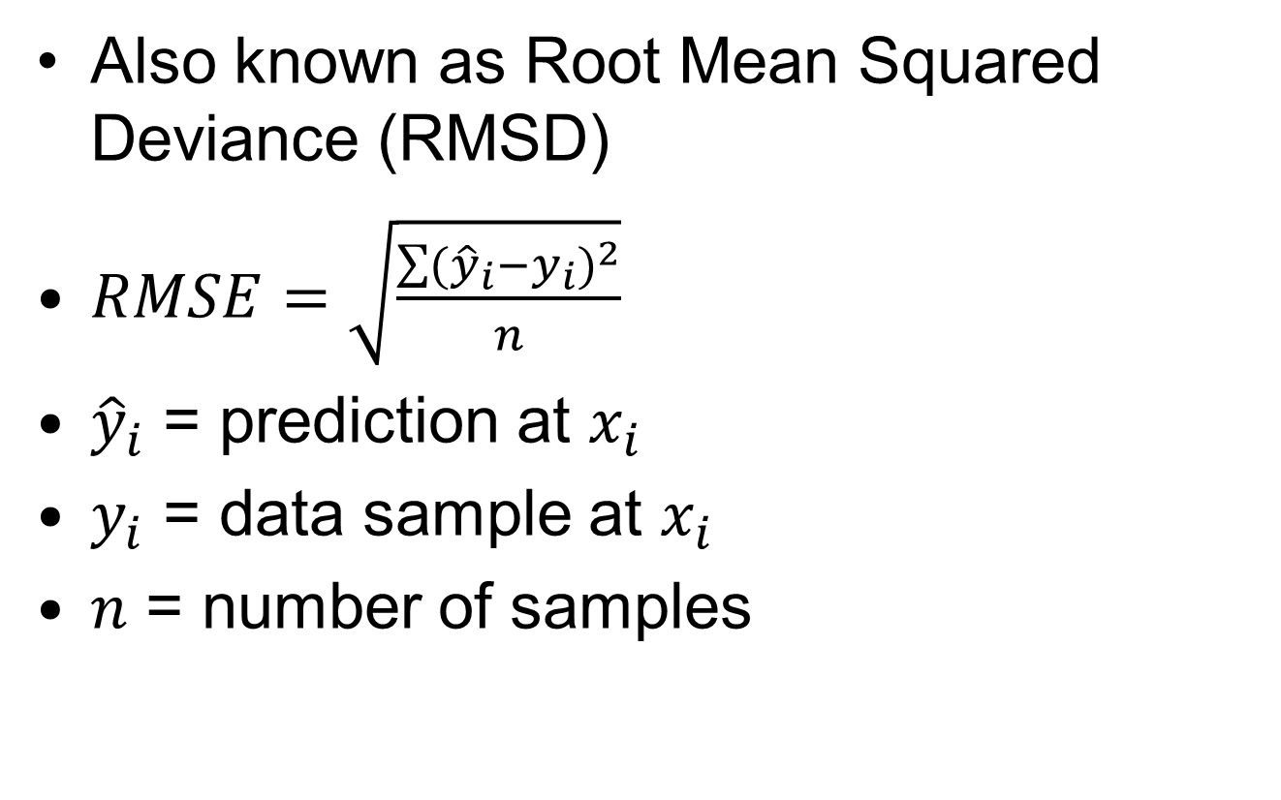
Root Mean Squared Error
Also known as Root Mean Squared Deviance (RMSD)
$RMSE=\sqrt{\frac{\sum{{({\hat{y}}_{i}−y_{i})}^{2}}}{n}}$
${\hat{y}}_{i}$ = prediction at $x_{i}$
$y_{i}$ = data sample at $x_{i}$
$n$ = number of samples

Slide 9
General Approach
Create the “default” model
Test the model by:
  Splitting into test and training data sets
  Train (fit) the model on the training data
    Inject error into response and covariants
  Validate the model against the test data
    Inject error into coefficients
  Create Maps
  Collect statistics: AIC, residuals, etc.
  Repeat until statistics stabilize
Summarize statistics

Slide 10
Anderson
We are not trying to model the data; instead, we are trying to model the information in the data. The goal is to recover the information that applies more generally to the process, not just to the particular data set. If we were merely trying to model the data well, we could fit high order Fourier series terms or polynomial terms until the fit is perfect. Data contain both information and noise; fitting the data perfectly would include modeling the noise and this is counter to our science objective.
Model Based Inference in the Life Sciences: A Primer on Evidence
By David R. Anderson

Slide 11
May be the same data
Field Data
Response, coordinates
Jackknife
Covariates
Direct or Remotely sensed
Predictors
Remotely sensed
Sample Data
Response, covariates
Qualify,
Prep
Qualify,
Prep
Qualify,
Prep
Random split?
Randomness
Inputs
Cross-Validation
Noise Injection
Outputs
Test Data
Training Data
Temp Data
Processes
Repeated
Over and Over
Build Model
Monte-Carlo
Randomize parameters
The Model
Sensitivity
Testing
Statistics
Validate
Predict
Randomness
Noise
Injection
Predicted Values
Uncertainty Maps
Summarize
Predictive Map

